Slide 1
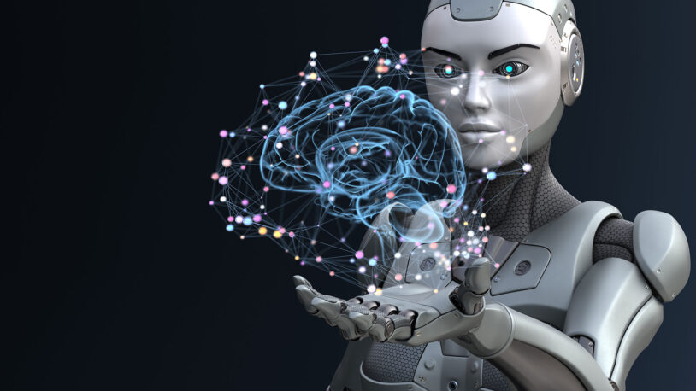
Detecting Brain tumors in Magnetic Resonance Imaging (MRI)
Group 5
Maliha Aziz, Zongzhu Li

Slide 2
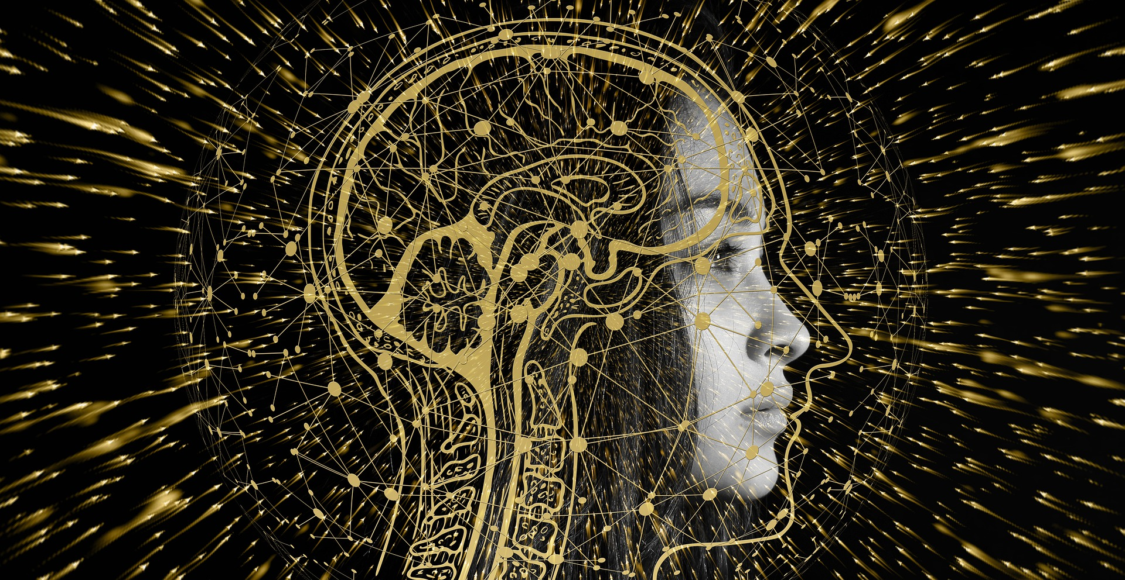
Outlines
Introduction
Overview of Dataset for Different Types of Brain Tumors
Data Preprocessing
Modeling, Prediction and Evaluation
SVM, KNN and Naïve Bayes
ANN with Parameters Exploratory
CNN
Summary and Discussion

Slide 3
Introduction
Challenges in Brain Cancer Treatment
Breaking through the blood-brain barrier
The challenges of surgical removal
The efficiency and accuracy of brain cancer diagnosis by doctors
Application of Machine Learning in Brain Cancer Diagnosis (3)
Increase the efficiency and accuracy of brain cancer diagnosis
Provide cloud diagnosis for people in the developing countries

Slide 4
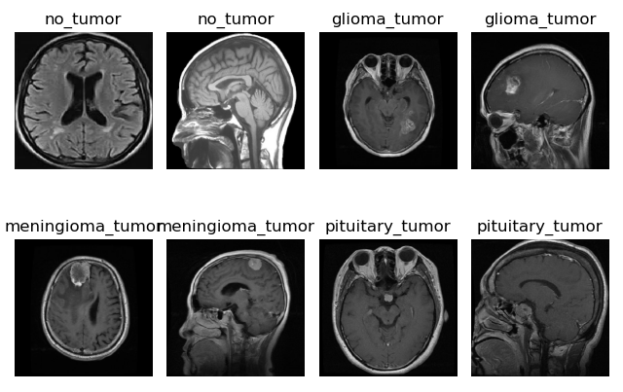
Overview of Dataset for 3 Types of Brain Tumors
{'glioma_tumor': 826, 'meningioma_tumor': 822, 'no_tumor': 395, 'pituitary_tumor': 827}
512 X 512 JPG file

Slide 5
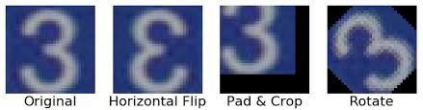
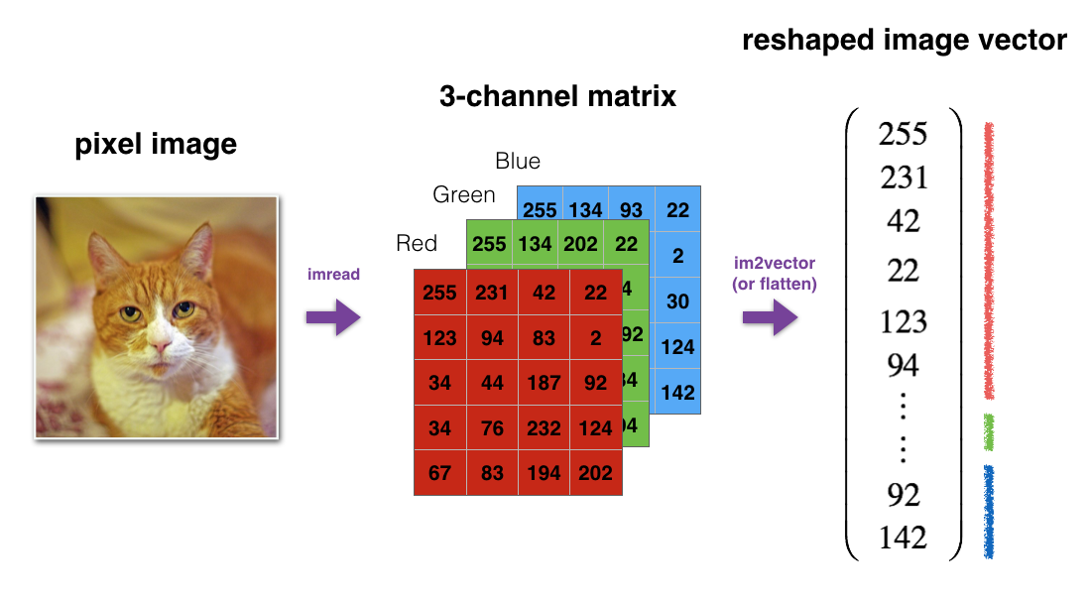
Data Preprocessing
Resize --- (128 X 128)
Transform to array from image
Normalization---(/255.0)
Data Augmentation---(ImageDataGenerator)
rotation_range=20,
width_shift_range=0.2,
height_shift_range=0.2,
zoom_range=0.2,
horizontal_flip=True
Data reshape from 3D to 2D
Notes:
# Image Data Augmentation: Image data augmentation is a technique that can
be used to artificially expand the size of a training dataset by creating modified versions of images in the dataset.
It uses techniques such as flipping, zooming, padding, cropping, etc. # Data augmentation makes the model more robust to slight variations, and hence prevents the model from overfitting.

Slide 6
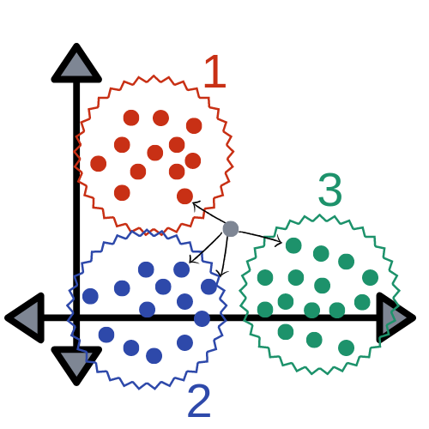
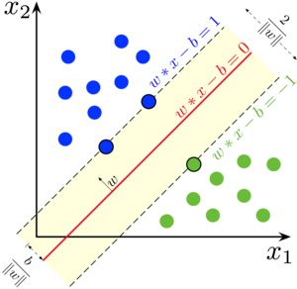
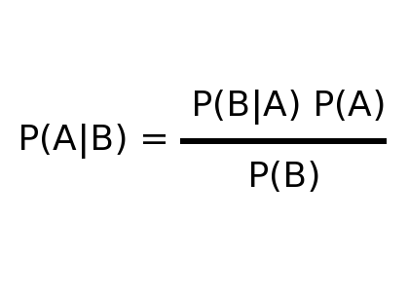
Modeling, Prediction and Evaluation
SVM
KNN
NB

Slide 7
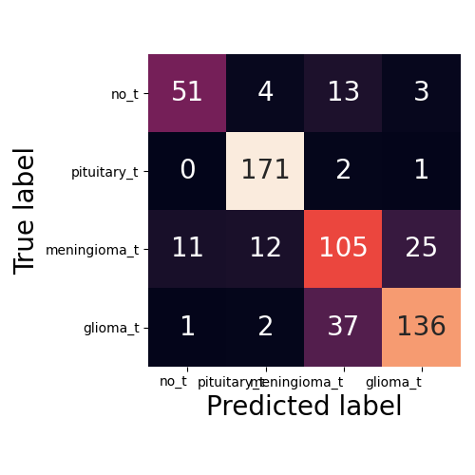
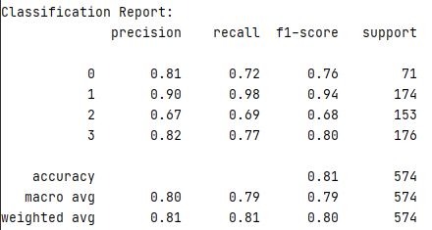
Modeling, Prediction and Evaluation - SVM
clf = SVC(kernel="poly")

Slide 8
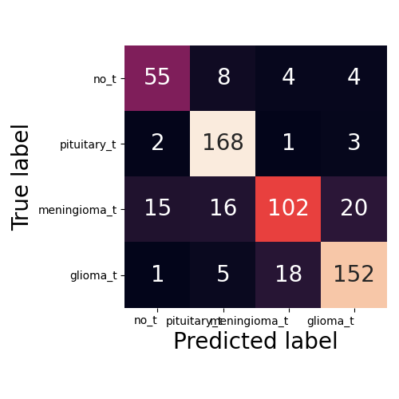
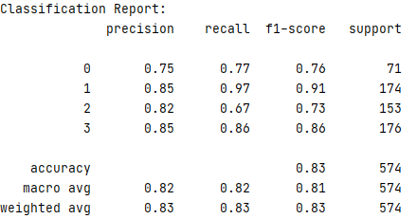
Modeling, Prediction and Evaluation - KNN
clf = KNeighborsClassifier(n_neighbors=4)

Slide 9
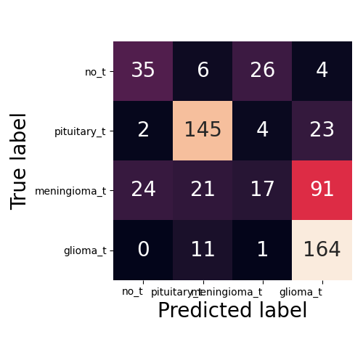
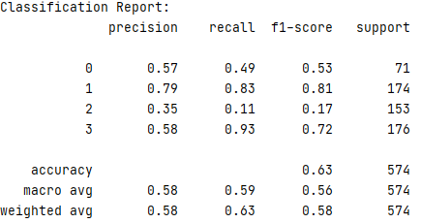
Modeling, Prediction and Evaluation - KNN
clf = GaussianNB()

Slide 10

Modeling, Prediction and Evaluation - ANN

Slide 11
Experiments Design and Results for ANN
ANN | Layers & Nodes | Iteration | Activation | Early-stopping | Solver | Accuracy (%)
01 | (20, 20) | 500 | “sigmoid” | False | Adam | 84.5
02 | (20, 20) | 500 | “relu” | False | Adam | 79.4
03 | (20, 20) | 500 | “sigmoid”, ”relu” | False | Adam | 82.1
04 | (500, 500) | 500 | “sigmoid” | True | Adam | 85.2
05 | (20, 20, 20,20) | 500 | “sigmoid” | False | Adam | 80.8
06 | (20, 20) | 2000 | “sigmoid” | False | Adam | 82.2
07 | (20,20) | 500 | “sigmoid” | False | SGD | 81.2
08 | (20, 20) | 500 | “sigmoid” | False | RMSprop | 84.8
09 | (20, 20) | 500 | “sigmoid” | False | Adagrad | 81.0
10 | (20, 20) | 500 | “sigmoid” | False | Adadelta | 78.6
11 | (20,20) | 500 | “sigmoid” | False | Adamax | 73.3
ANN | (500, 500, 20) | 500 | “sigmoid” | False | RMSprop | 87.5

Slide 12
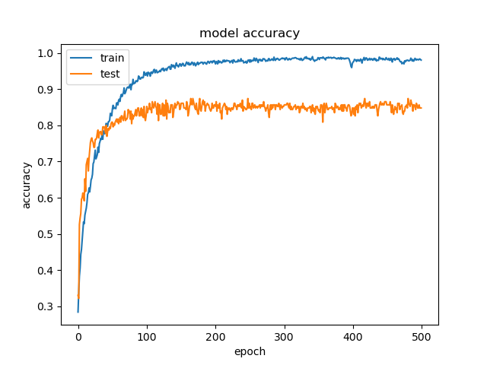
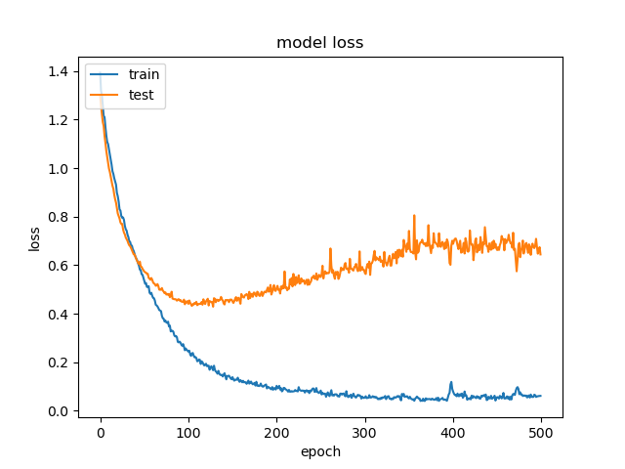
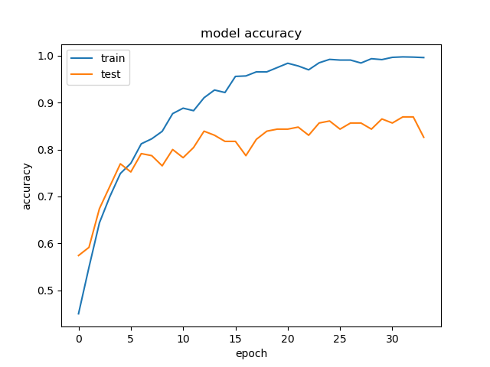
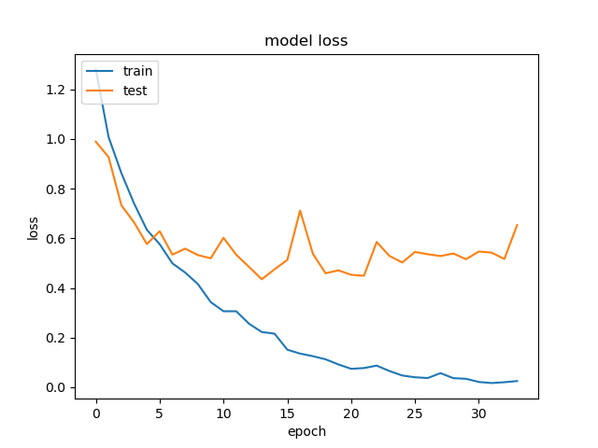
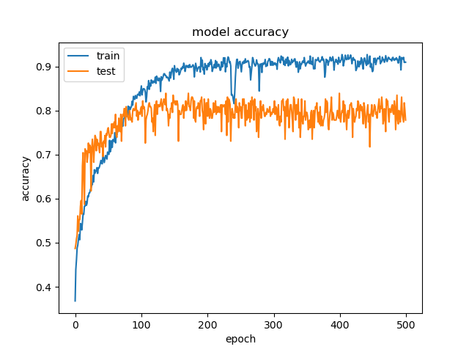
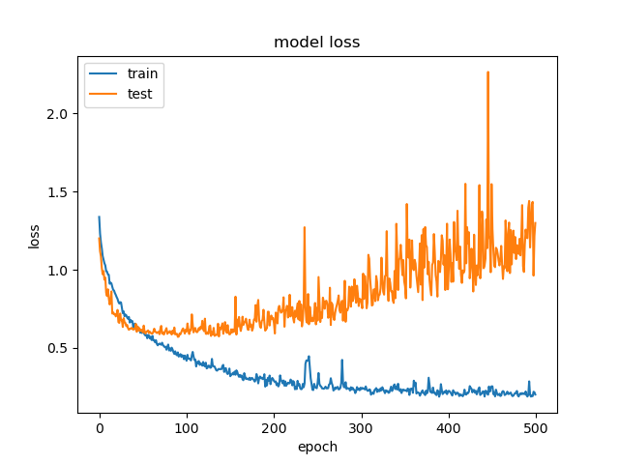
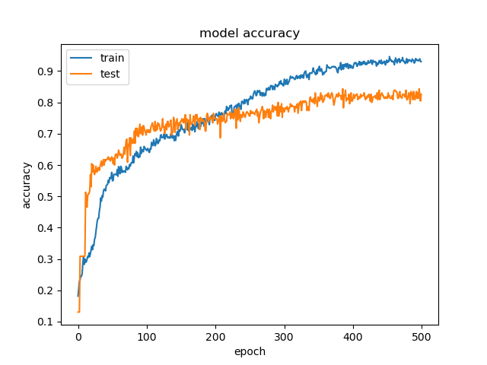
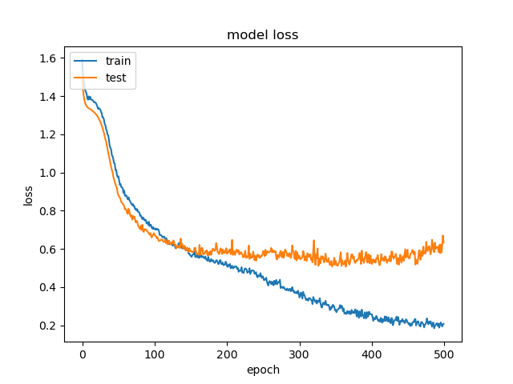
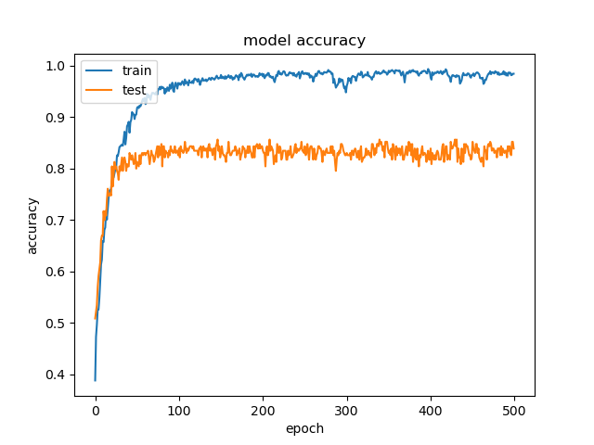
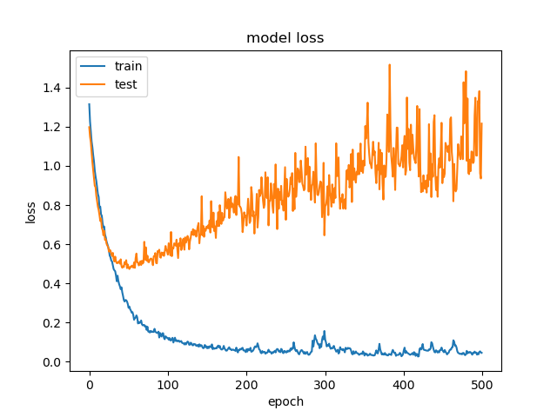
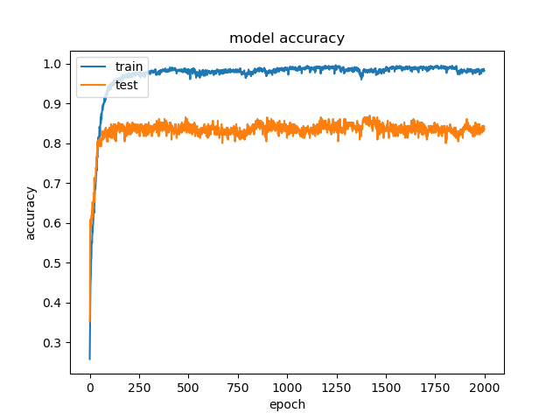
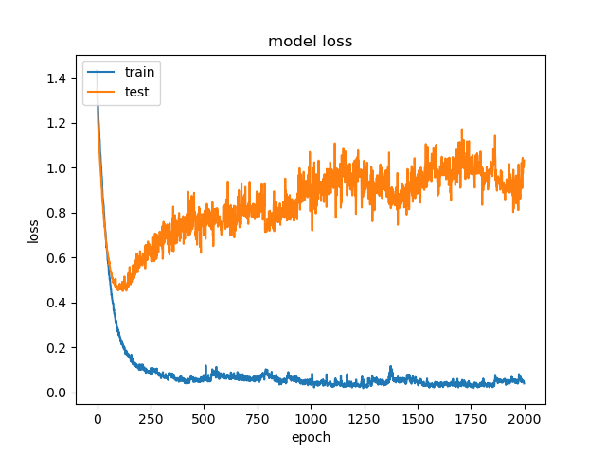
ANN
01
ANN
04
ANN
02
ANN
05
ANN
03
ANN
06

Slide 13
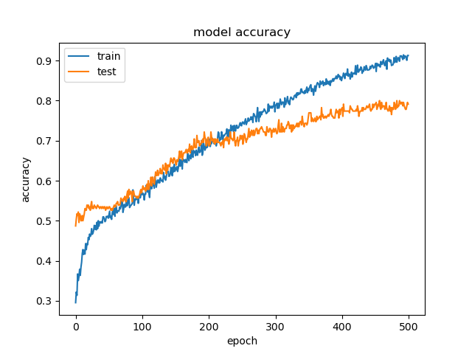
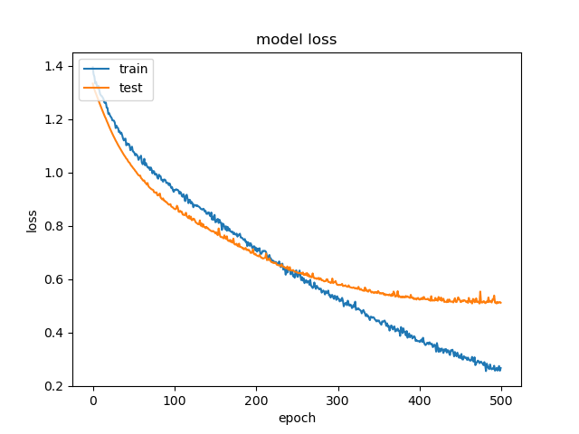
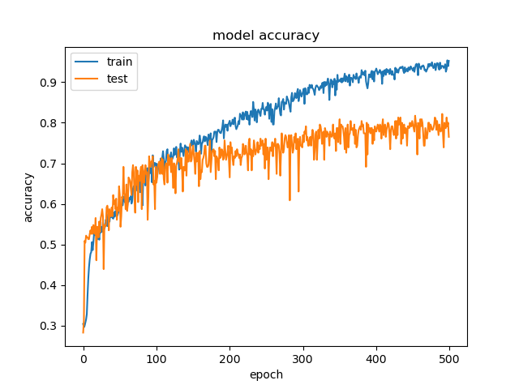
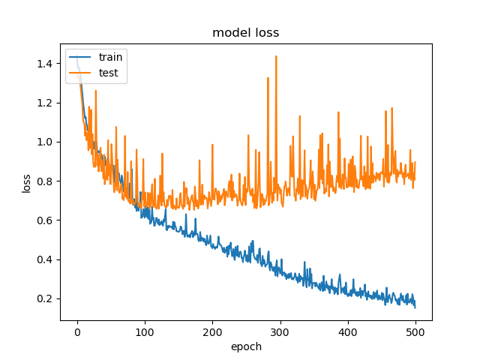
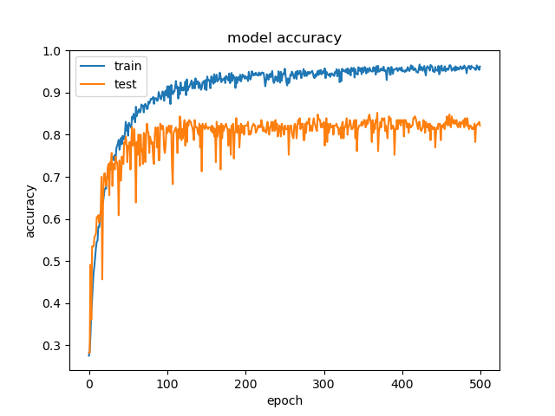
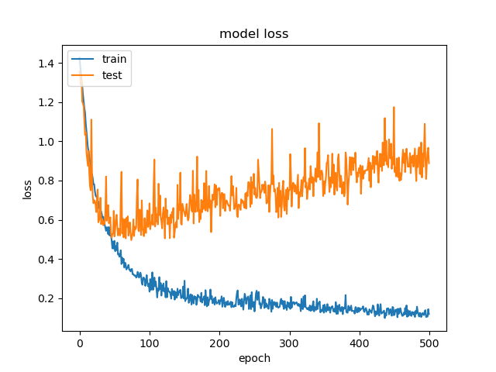
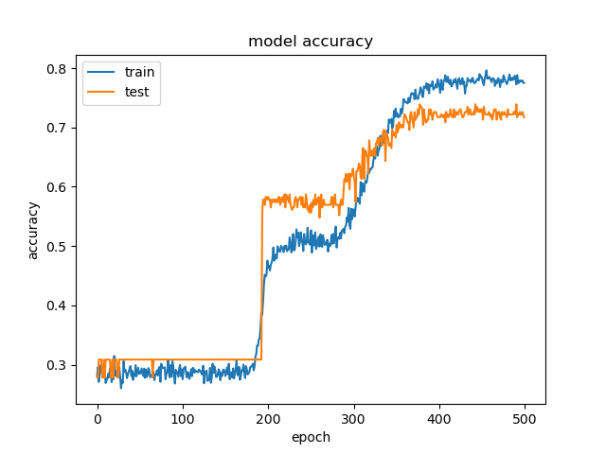
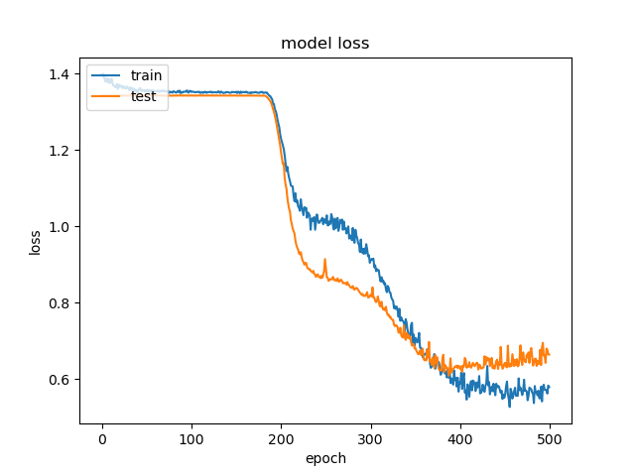
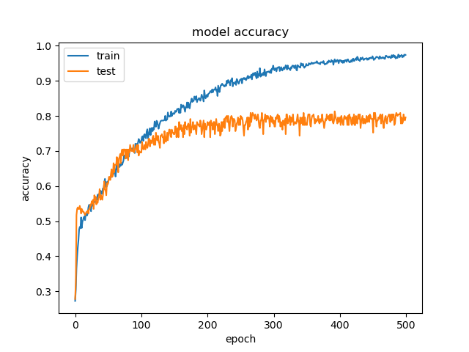
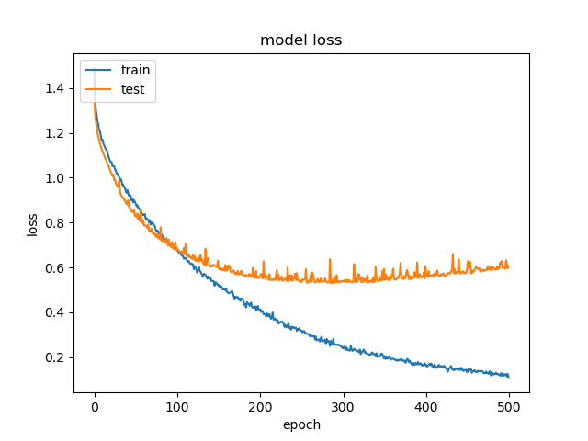
ANN
07
ANN
10
ANN
08
ANN
11
ANN
09

Slide 14
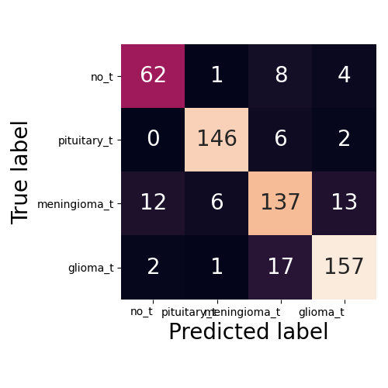
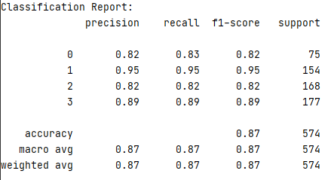
Modeling, Prediction and Evaluation - ANN
Hidden layers and Nodes: (500,500,20)/ Iteration: 500/ Activation: “sigmoid”/ Solver: RMSpro (lr=0.001)

Slide 15
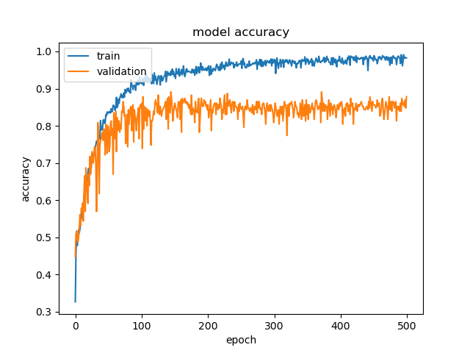
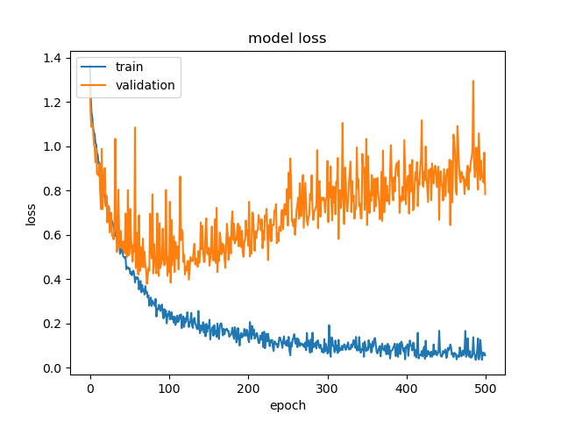
Modeling, Prediction and Evaluation - ANN

Slide 16
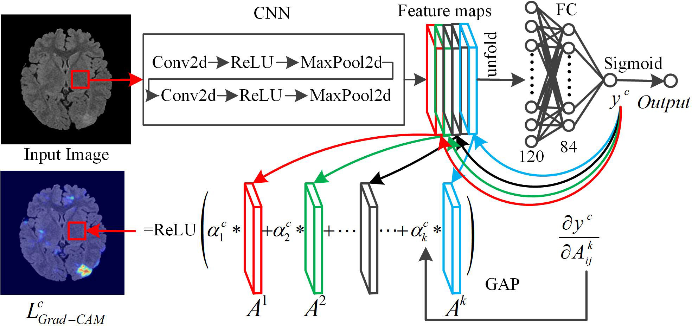
Modeling, Prediction and Evaluation - CNN

Slide 17
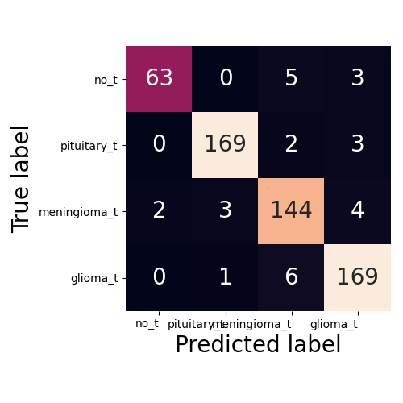
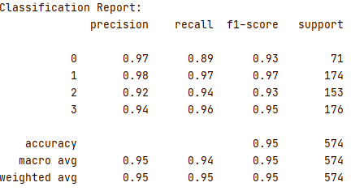
Modeling, Prediction and Evaluation - CNN

Slide 18
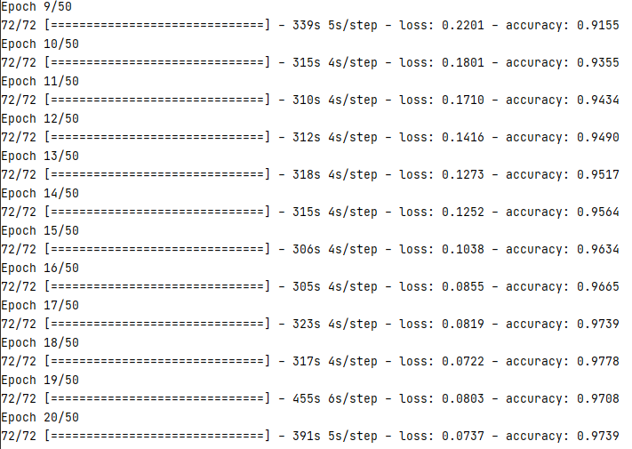
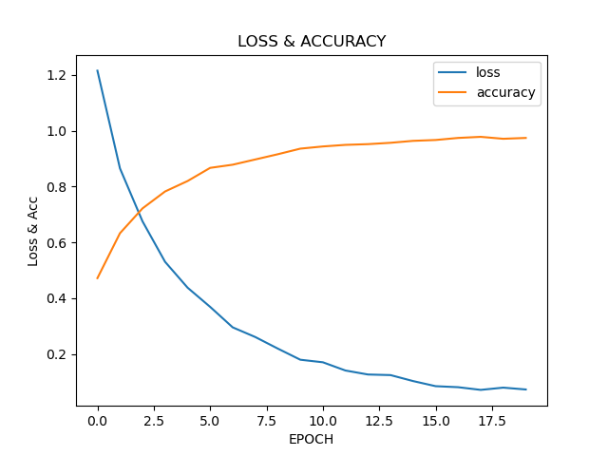
Modeling, Prediction and Evaluation - CNN

Slide 19
Summary and Discussion

Slide 20
References
1. Aldape, K., Brindle, K.M., Chesler, L. et al. Challenges to curing primary brain tumours. Nat Rev Clin Oncol 16, 509–520 (2019). https://doi.org/10.1038/s41571-019-0177-5
2. Cao, H., Erson-Omay, E.Z., Li, X. et al. A quantitative model based on clinically relevant MRI features differentiates lower grade gliomas and glioblastoma. Eur Radiol 30, 3073–3082 (2020). https://doi.org/10.1007/s00330-019-06632-8
3. Nadeem, M. W., Ghamdi, M., Hussain, M., Khan, M. A., Khan, K. M., Almotiri, S. H., & Butt, S. A. (2020). Brain Tumor Analysis Empowered with Deep Learning: A Review, Taxonomy, and Future Challenges. Brain sciences, 10(2), 118. https://doi.org/10.3390/brainsci10020118
4. Hollon, T.C., Pandian, B., Adapa, A.R. et al. Near real-time intraoperative brain tumor diagnosis using stimulated Raman histology and deep neural networks. Nat Med 26, 52–58 (2020). https://doi.org/10.1038/s41591-019-0715-9
5.
6.
7.
8.

